Slide 1
IRT
Dichotomous + Polytomous

Slide 2
Install your packages!
Logistic distribution estimation = ltm package
ltm()
Normal distribution estimation = psych package
irt.fa()
Polytomous IRT – mirt package

Slide 3
An example IRT
Mac users:
curl -O http://r.research.att.com/libs/gfortran-4.8.2-darwin13.tar.bz2
sudo tar fvxz gfortran-4.8.2-darwin13.tar.bz2 -C /

Slide 4
Load the Data
We are going to use a pre built in dataset – you DO have to have to raw data for IRT analysis, since that’s kind of the point.
data(LSAT)
head(LSAT)

Slide 5
2PL Model
Code:
IRTmodel = ltm(LSAT ~ z1, IRT.param = TRUE)
Arguments
Data ~ z1 (z1 is a required thing)
IRT.param = TRUE keeps the a, b values in the traditional format

Slide 6
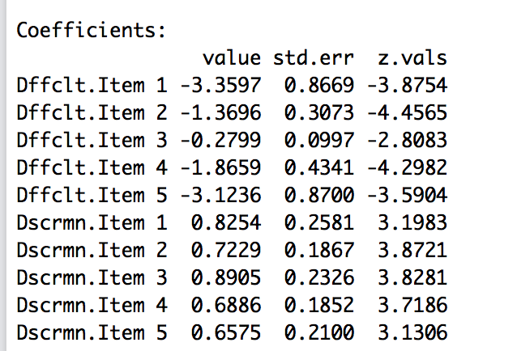
2PL Model
We’ve run a one-factor 2PL model.
Let’s look at some output with the summary function.

Slide 7
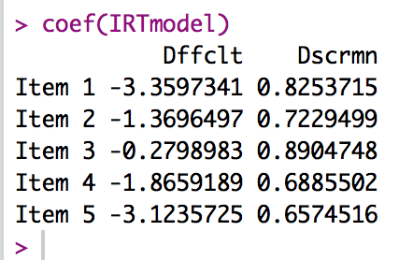
2PL Model
That’s not the easiest output to read, so instead let’s use the coef() function to get the coefficients in a nice table.
Remember for a 2PL we have:
Difficulty = b = theta = ability
Discrimination = a = how good the question is at figuring a person out.

Slide 8
2PL Model
Let’s make some plots!
plot(IRTmodel, type = "ICC") ## all items at once
plot(IRTmodel, type = "ICC", items = 1) ## one item at a time
plot(IRTmodel, type = "IIC", items = 0) ## Test Information Function

Slide 9
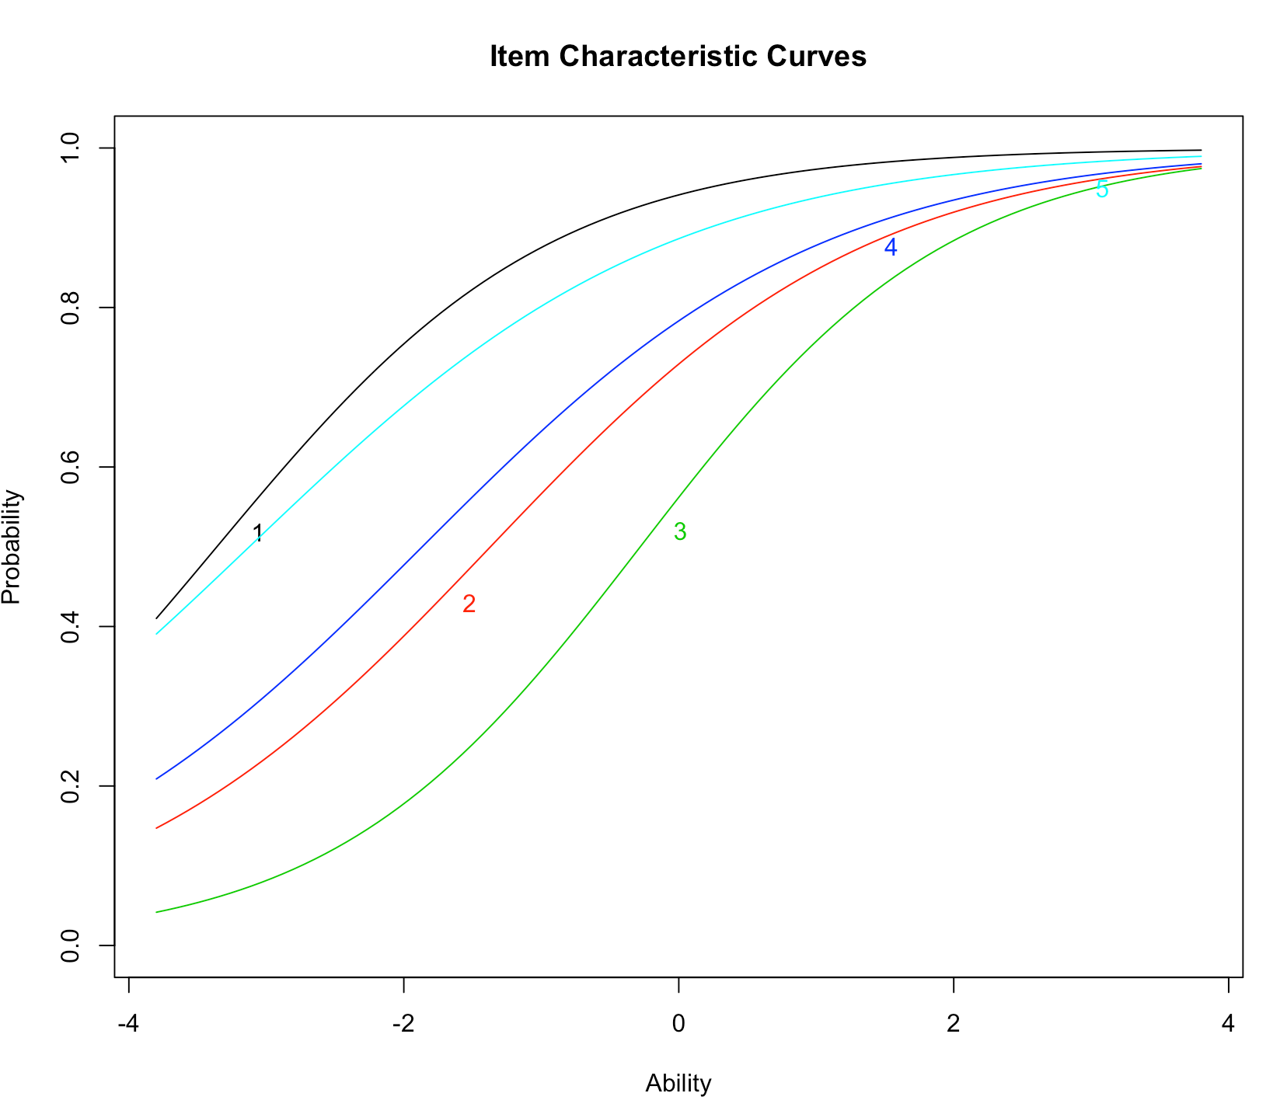

Slide 10
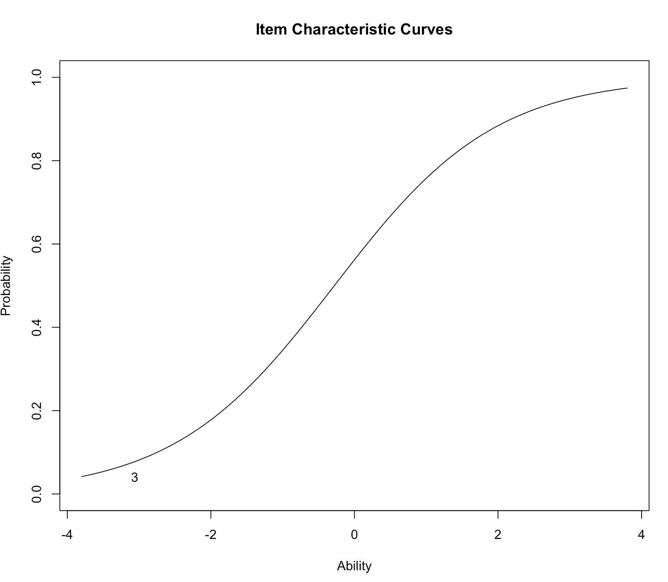

Slide 11
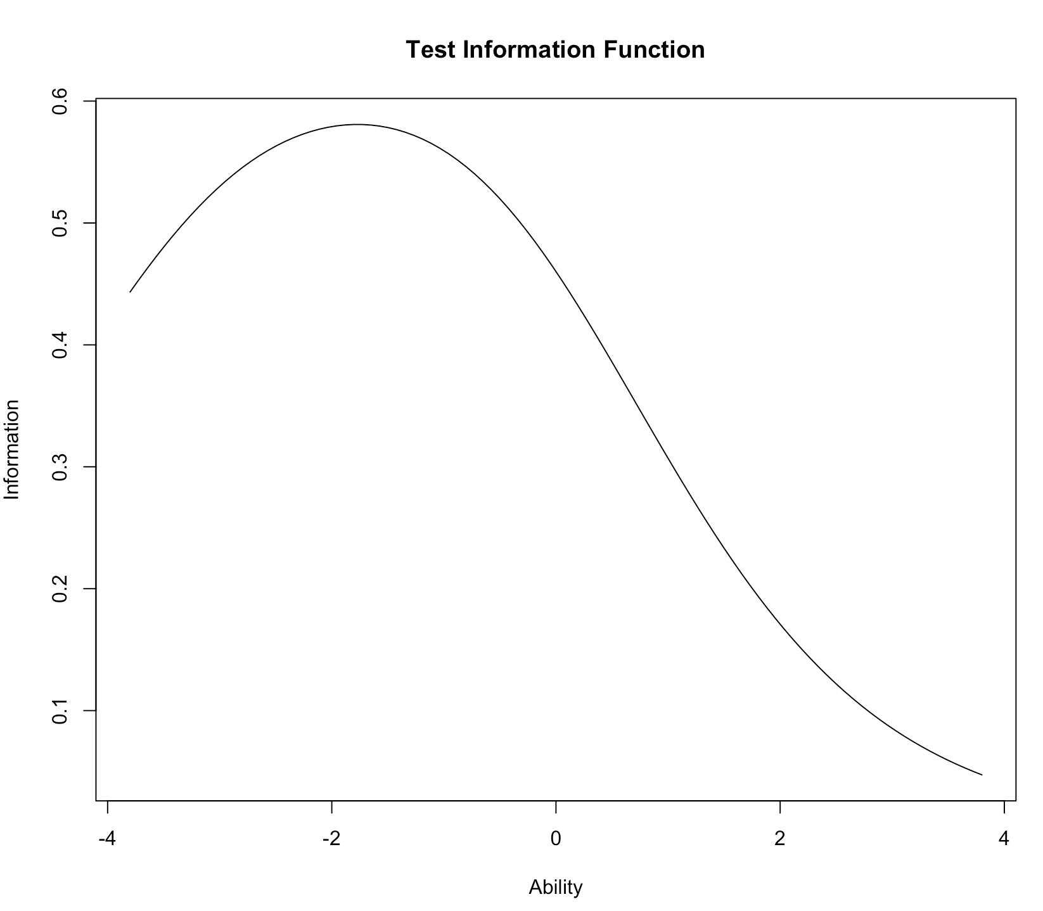

Slide 12
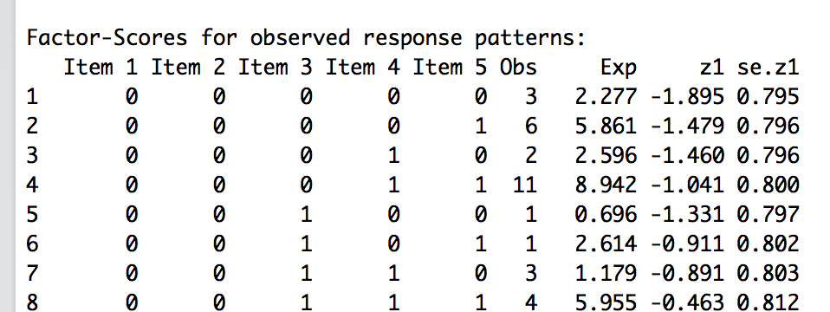
2PL Model
Factor scores = each response pattern
Observed number of those patterns versus expected number of those patterns.
Z is the ability estimate for each pattern.

Slide 13
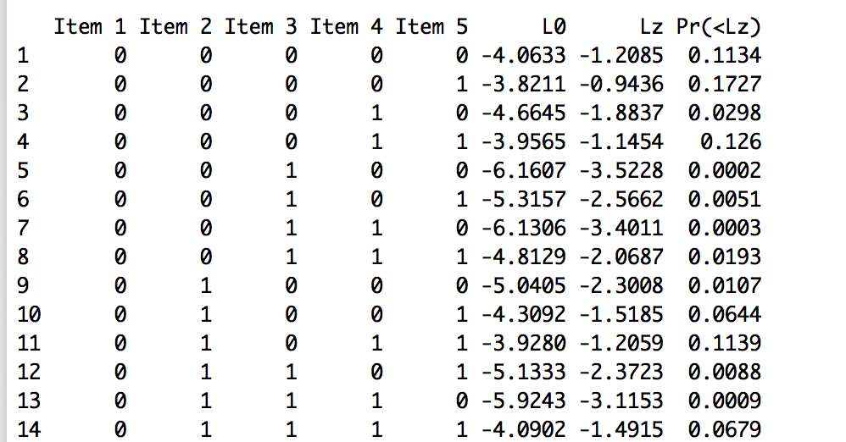
2PL Model
Person fit is each person’s pattern of data and their corresponding ability estimate
Use the Lz column.

Slide 14
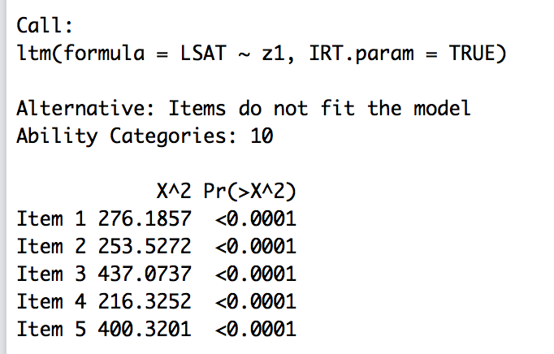
2PL Model
The probability that the items do not fit the model (want non-significant).

Slide 15
3PL Model
Let’s try the same data with a 3PL to include guessing.
Use a different function:
tpm(data, type = “latent.trait”, IRT.param = TRUE)
TPM = three parameter model
The rest stays the same, so you get the same types of output as for the 2PL.

Slide 16
3PL Model
Let’s look at:
Coefficients
Plots
Factor, person scores
Item fit

Slide 17
Compare Models
Use the anova() function to compare to see if the addition of the guessing parameter helped.
anova(model 1, model 2)

Slide 18
Polytomous IRT
First, load the dataset:
Normally, you would data screen the dataset, but we are just going to eliminate non complete data for this example.
Be sure to reverse code any items!
This scale actually consists of two subscales, so we are going to analyze each one separately (you could also try multidimensional IRT).

Slide 19
Polytomous IRT
Run the model:
mirt(data = data,
model = 1, ##for one factor
itemtype = “gpcm”) ##generalized partial credit model

Slide 20
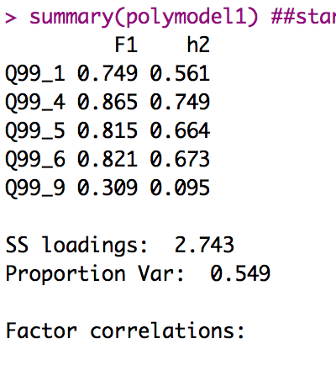
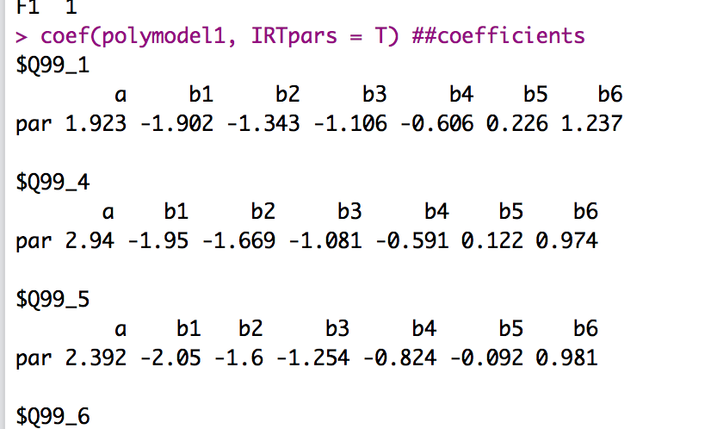
Polytomous IRT
Look at the coefficients / standardized loadings:

Slide 21
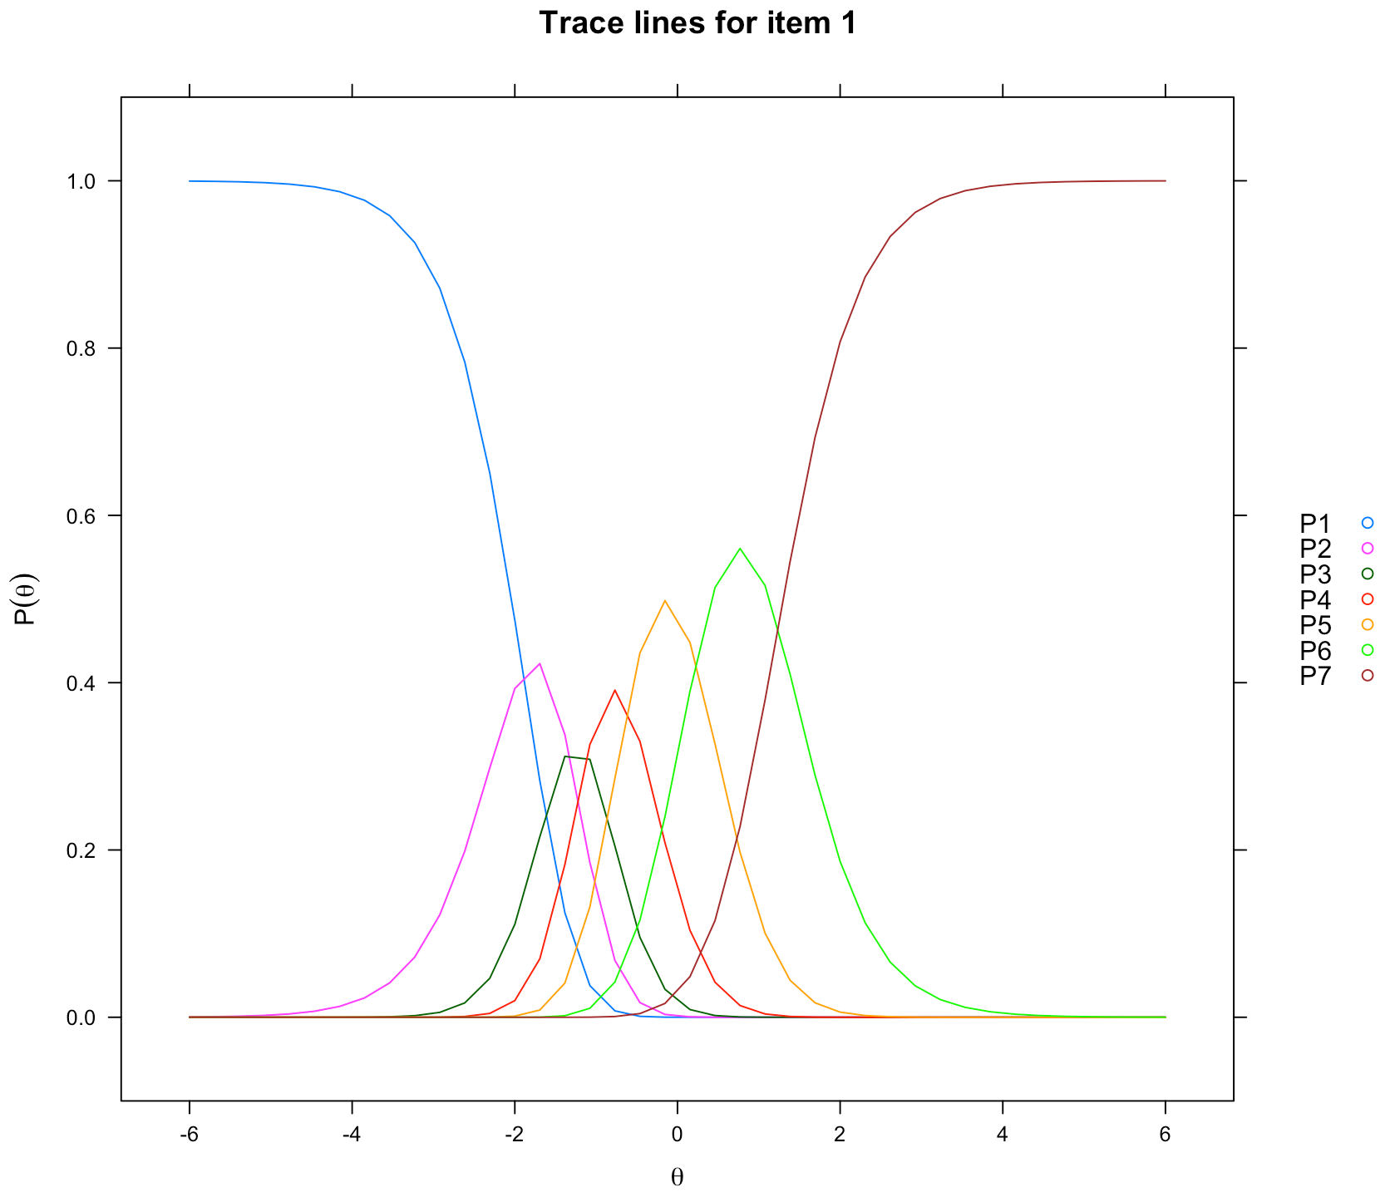
Polytomous IRT
Create an item plot for one item:

Slide 22
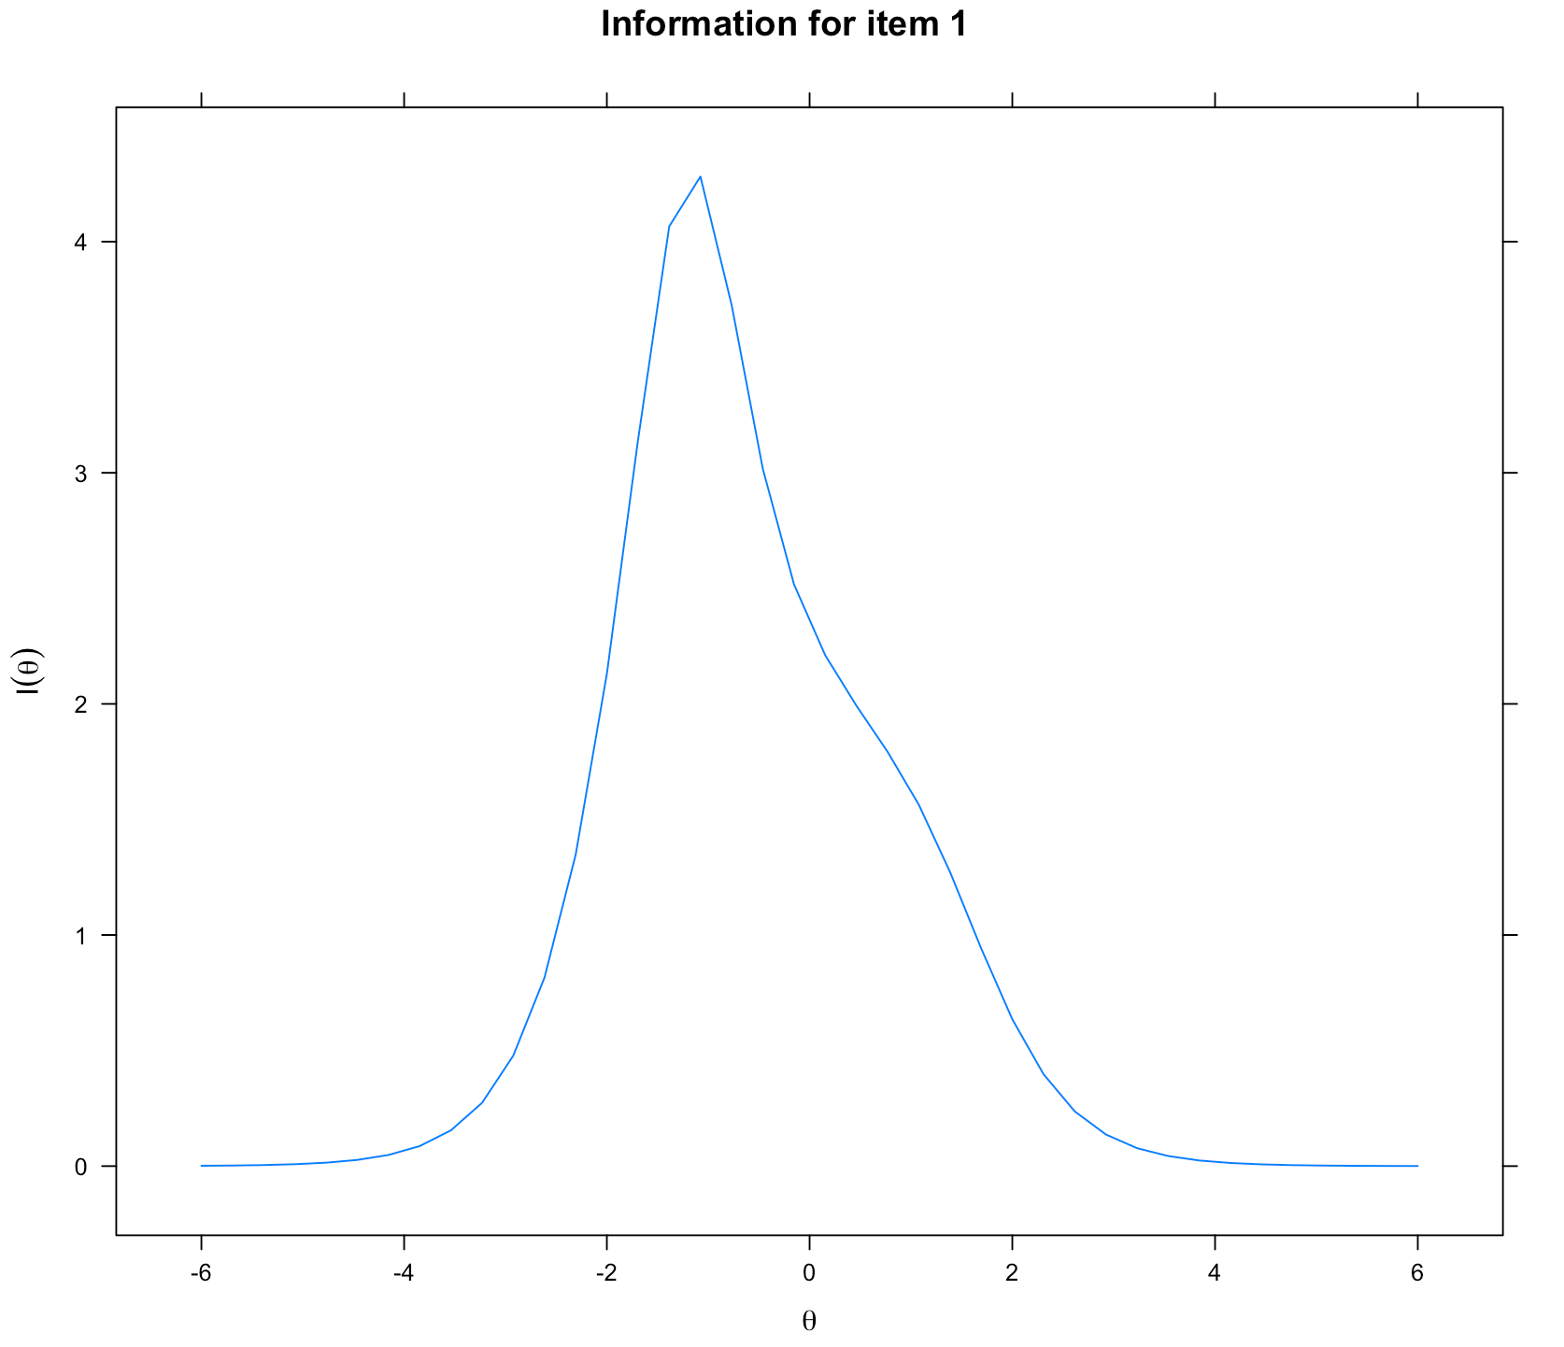
Polytomous IRT
Create a plot of the information curve:

Slide 23
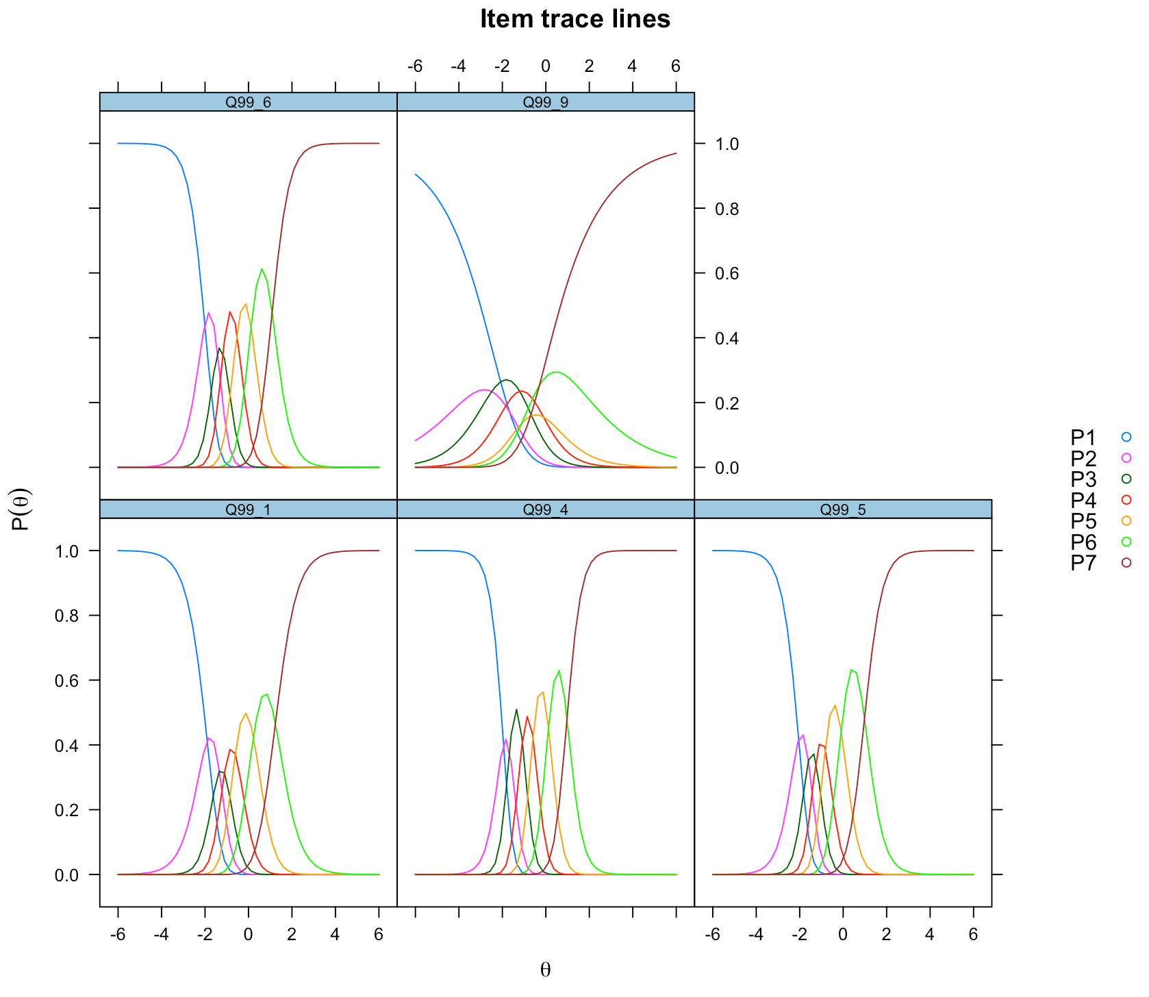
Polytomous IRT
Plot all items at once:

Slide 24
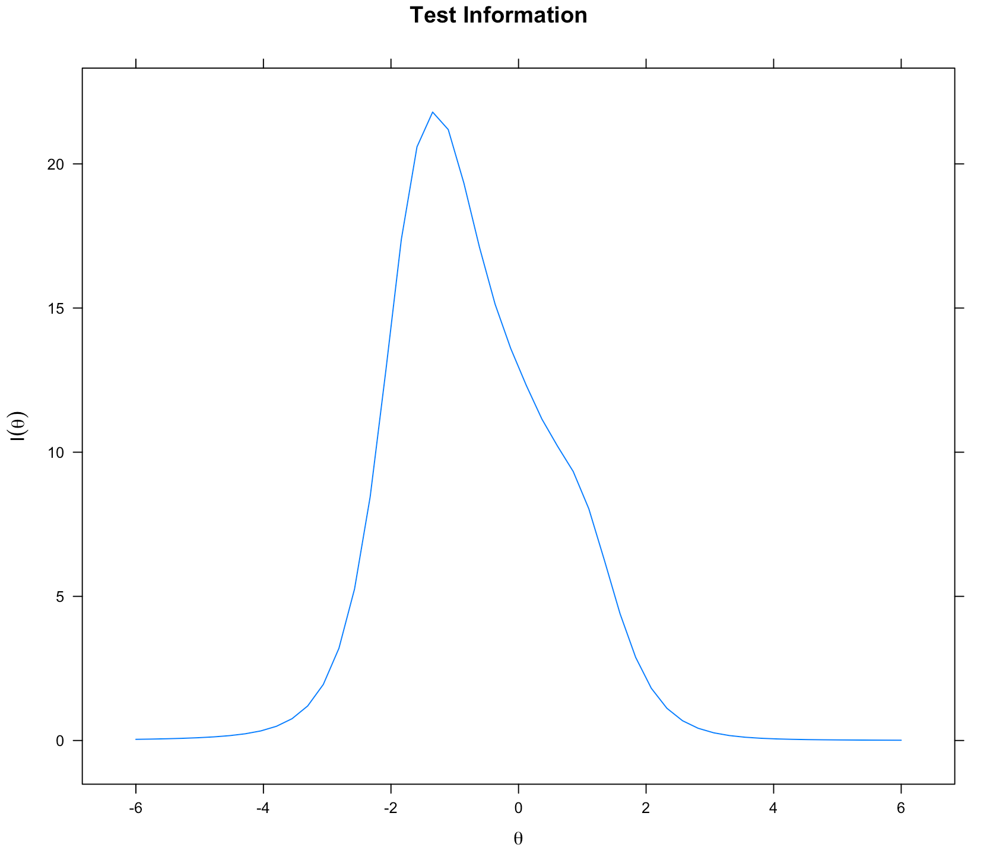
Polytomous IRT
Plot test information function:

Slide 25
Polytomous IRT
You can also look at each person’s expected ability score, item fit (want non significant), and person fit statistics.

Slide 26
Interpretation
For IRT, you can treat it similar to an EFA – if items are bad, you can toss them and run the analysis again.
If you are just trying to analyze the questions, may not be necessary, but if you are designing scales, taking out bad items would be good.

